Slide 1
Legal Advice on the Smartphone
Cyber Security Paper Presentation
Submitted to : Dr. Stefan Andrei
Presented By : Bhumit Patel

Slide 2
Outline
Author Introduction
Legal Advice Problem
Solution
WinIt Application
Similar Applications
Conclusion
References

Slide 3
Author Introduction
The author of an article “Legal Advice on the Smartphone” is Keith Kirkpatrick.
He is a business owner, writer, researcher, analyst, and project manager with 20 years of relevant experience.
The author is spend 8 years of his career researching, writing, and editing primarily on technology topics.
He is founder of 4K Research & Consulting, LLC, provider of qualitative and quantitative primary research, desk-research, and consulting services.

Slide 4
Legal Advice Problem
Successfully challenging a summons or ticket can be challenging and time-consuming.
Among driver's greatest annoyances are parking and traffic tickets.
For the average person, the time and effort to acquire such arcane knowledge often outweighs the desire to fight the ticket.

Slide 5
Cont.…
The process of fighting a ticket traditionally has included conducting the lots of research to determine whether or not a ticket might be dismissible.
After then going through a time-consuming process to actually appeal the ticket, either via mail or by heading to traffic court to fight the ticket in person.

Slide 6
Solution
Not surprisingly, applications designed to help access and navigate through the legal system are quickly gaining favor among the public.
The App helps you fight parking and traffic tickets to that report violations, mobile technology apps are stepping in to serve as an on-the-go legal assistant.

Slide 7
WinIt Application
WinIt, a mobile app available on the iOS and Android platforms.
This app helps users by providing an algorithm that identifies the type of ticket.
And then automatically provides a list of the evidence or documentation that is most likely to help convince a judge to dismiss a ticket or reduce a fine.

Slide 8
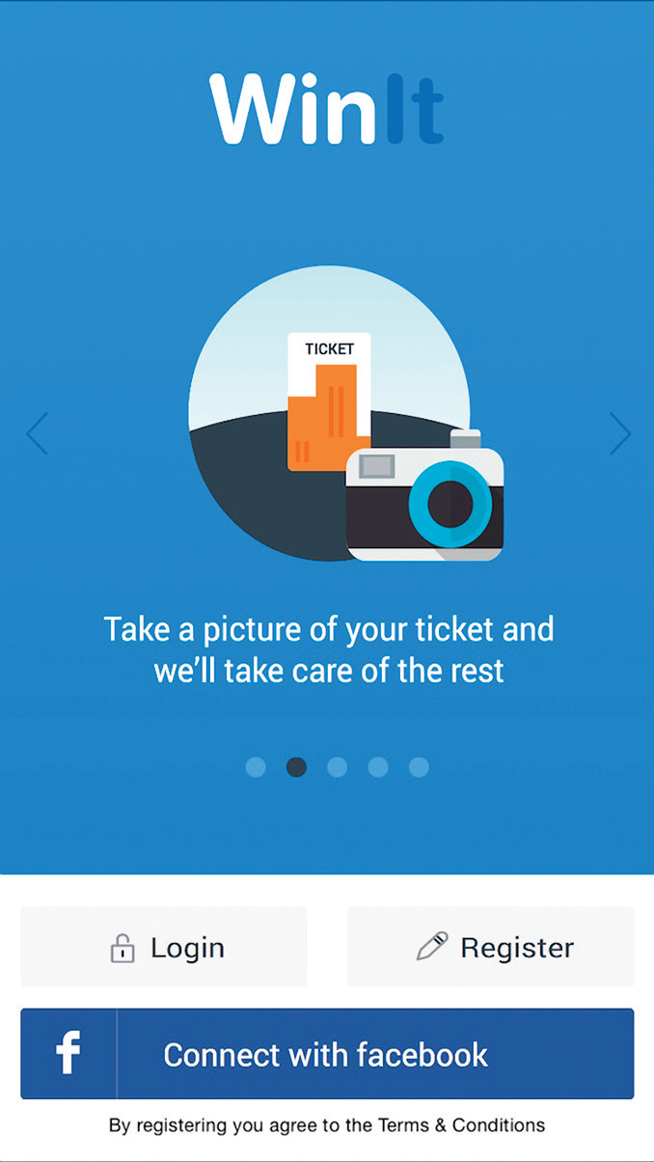
WinIt Application
Here is the screenshot of WinIt application.

Slide 9
Cont.…
Once the app has been downloaded, users simply need to take a clear picture of the ticket, and then submit it to WinIt.
The benefit to users is being able to quickly determine whether or not it will be worth the time to fight a ticket.
After the user provides the documentation, WinIt taps into the parking-law experts, review the documents, and will contest the ticket on the user’s behalf in the court.

Slide 10
Cont.…
If a user cannot provide such documentation, WinIt says the likelihood a ticket will be dismissed is very low.
However, the app, which provides users a way to easily evaluate whether a challenge is likely to be successful without going through the entire process of contesting a ticket.
If WinIT gets the ticket dismissed, the user pays the company 50% of the value of the fine; if the ticket is not dismissed, the user simply needs to pay the fine in full, and owes WinIT no fee.

Slide 11
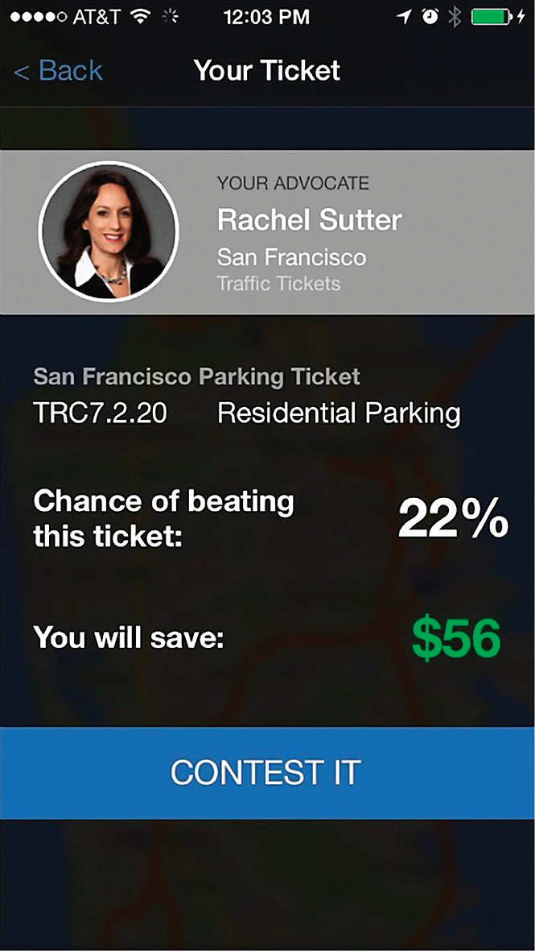
Similar Applications
Another provider based in California has already made that move into moving violations.
Fixed was founded by David Hegarty to
streamline the process of fighting parking tickets
by capturing ticket data, submitting the
challenge to the respective municipal parking
authority, and matching app users with
attorneys, if so desired.

Slide 12
Cont.…
An app released in 2009 by Parking Mobility, a non-profit group dedicated to addressing accessible parking abuse, lets users capture and report instances of people who illegally park in handicapped-accessible parking spots.
Once the app downloaded, it asks users to capture three photos of an alleged violation.

Slide 13
Cont.…
Casual users can be located anywhere, and their violation reports are automatically collected by Parking Mobility.
Then passes along the data to the relevant municipalities to highlight the problem of accessible parking violations, with the eventual goal of creating a partnership between the jurisdiction and citizen volunteers, who are deputized and allowed to issue parking citations via the app.

Slide 14
Conclusion
Currently, Parking Mobility has partnerships with jurisdictions in Texas, Kansas, and Oregon, and is negotiations with jurisdictions in Florida, Georgia, North and South Carolina, Arizona, and Colorado.
Still, whether a partnership has been struck or not, “we encourage the use of the Parking Mobility App everywhere,” Marsh says. “Reports in nopartner communities are as important, if not more so, than reports which result in citations, data from reports is the only way to get communities to issue citations.”

Slide 15
References
http://cacm.acm.org/magazines/2016/7/204022-legal-advice-on-the-smartphone/fulltext
http://www.4kresearch.com/about-4k-research--consulting-llc.html
https://nakedsecurity.sophos.com/2015/10/15/fixed-app-that-fights-parking-ticketsblocked-in-3-cities/
https://www.youtube.com/watch?v=vyCax5yVyC8

Slide 16


Contact: bpatel13@lamar.edu

